Slide 1
Recursion Examples

Slide 2
Recursion (review)

Slide 3
Recursion (review)
Scenario: You are waiting in line for a concert. You can't see the front of the line, but you want to know your place in the line.
The person at the front, knows they are at the front!
Base case
You ask the person in front of you: “what is your place in the line?”
Recursive call
When the person in front of you figures it out and tells you, add one to that answer.
Use the solution to the smaller problem

Slide 4
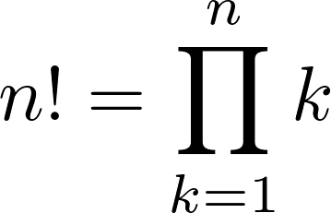
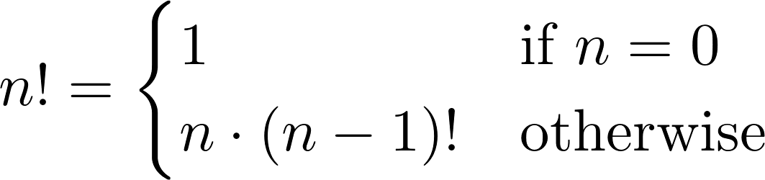
Iteration vs. Recursion
Iteration and recursion are somewhat related
Converting iteration to recursion is formulaic, but converting recursion to iteration can be more tricky
Iterative
Recursive
def fact_iter(n): total, k = 1, 1 while k <= n: total, k = total*k, k+1 return total
def fact(n): if n == 0: return 1 else: return n * fact(n-1)
Names: n, total, k, fact_iter
Names: n, fact

Slide 5
Sum Digits
Let’s implement a recursive function to sum all the digits of `n`. Assume `n` is positive.
def sum_digits(n):
"""Calculates the sum of
the digits `n`.
>>> sum_digits(8)
8
>>> sum_digits(18)
9
>>> sum_digits(2018)
11
"""
"*** YOUR CODE HERE ***"
One or more base cases
One or more recursive calls with simpler arguments.
Using the recursive call to solve our larger problem.

Slide 6
Sum Digits
1 def sum_digits(n):
2 """Calculates the sum of the digits n
3 >>> sum_digits(8)
4 8
5 >>> sum_digits(18)
6 9
7 >>> sum_digits(2018)
8 11
9 """
10 if n < 10:
11 return n
12 else:
13 all_but_last, last = n // 10, n % 10
14 return sum_digits(all_but_last) + last

Slide 7
Order of Recursive Calls
Notes:
see demo 1

Slide 8
Cascade
Demo
Goal: Print out a cascading tree of a positive integer n.
>>> cascade(486)
Ideas:
If n is a single digit, just print it out!
486
48
4
48
486
Otherwise, let cascade(n // 10) take care of the middle
and print(n) around it
>>> cascade(48)
1 def cascade(n):
1 def cascade(n):
2 if n < 10:
3 print(n)
1 def cascade(n):
2 if n < 10:
3 print(n)
4 else:
5 print(n)
6 cascade(n // 10)
7 print(n)
48
4
48
>>> cascade(4)
4

Slide 9
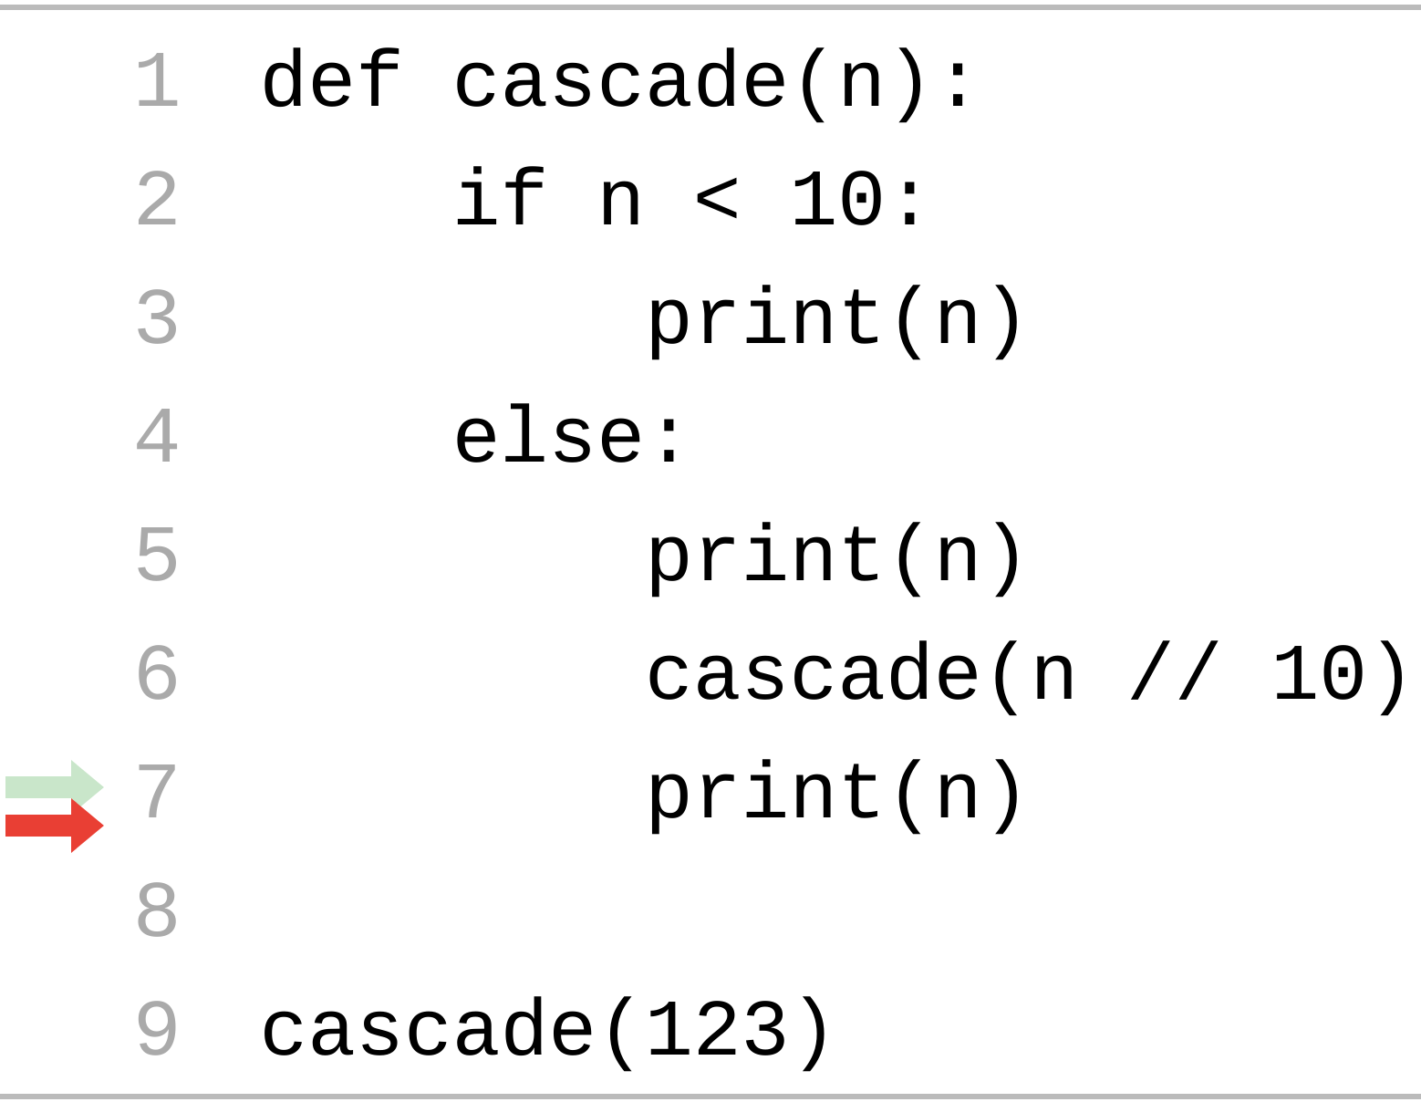
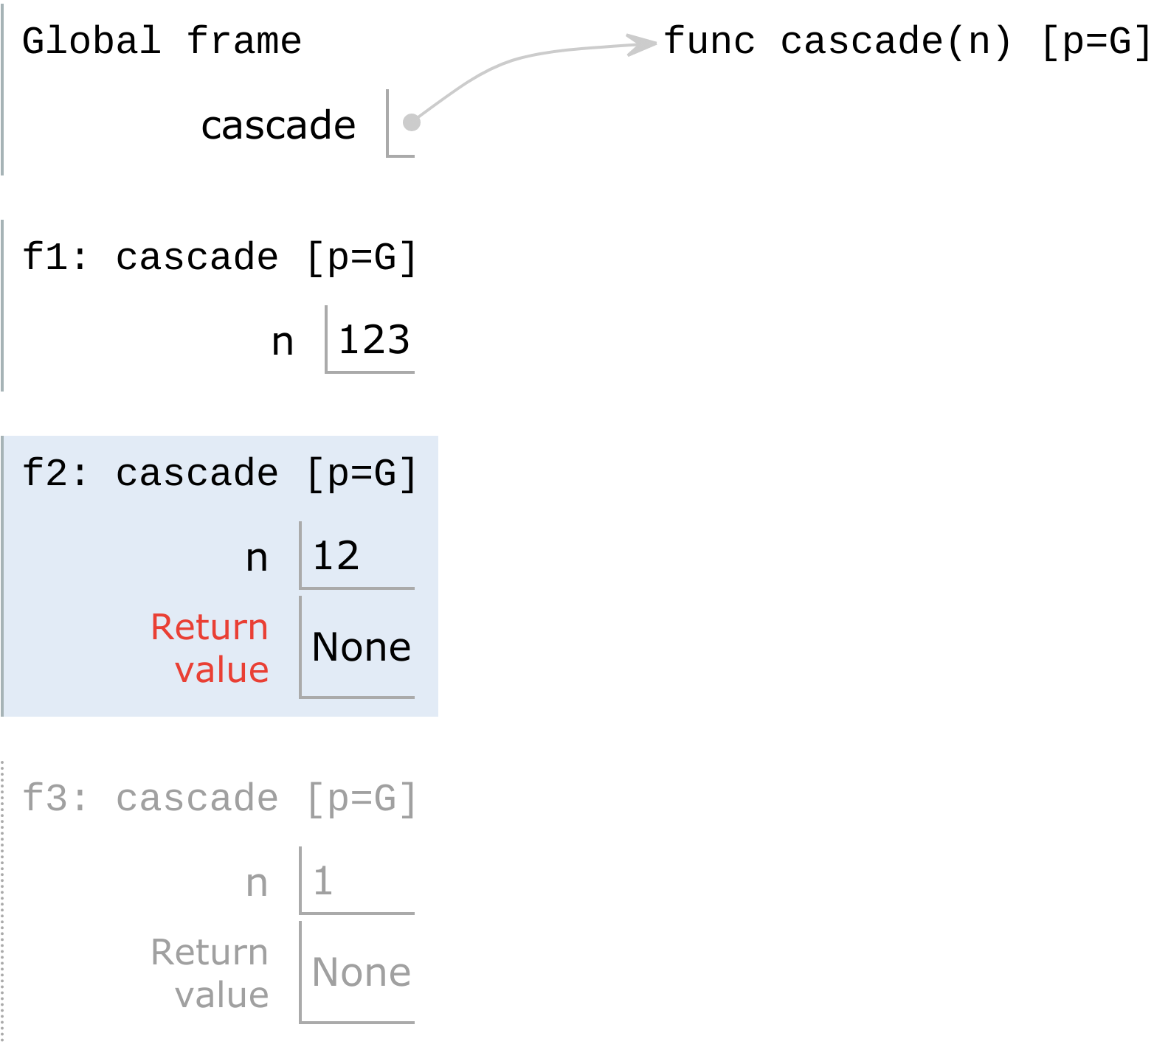
The Cascade Function
Each cascade frame is from a different call to cascade.
Until the Return value appears, that call has not completed.
Any statement can appear before or after the recursive call.
Output
123 12 1 12
Base case
Notes:
http://pythontutor.com/composingprograms.html#code=def%20cascade%28n%29%3A%0A%20%20%20%20if%20n%20%3C%2010%3A%0A%20%20%20%20%20%20%20%20print%28n%29%0A%20%20%20%20else%3A%0A%20%20%20%20%20%20%20%20print%28n%29%0A%20%20%20%20%20%20%20%20cascade%28n//10%29%0A%20%20%20%20%20%20%20%20print%28n%29%0A%0Acascade%28123%29&cumulative=true&curInstr=0&mode=display&origin=composingprograms.js&py=3&rawInputLstJSON=%5B%5D

Slide 10
Two Implementations of Cascade
Demo
1 def cascade(n):
2 if n < 10:
3 print(n)
4 else:
5 print(n)
6 cascade(n // 10)
7 print(n)
1 def cascade(n):
2 print(n)
3 if n >= 10:
4 cascade(n // 10)
5 print(n)
If two implementations are equally clear, then shorter is usually better
In this case, the longer implementation might be more clear
When learning to write recursive functions, put the base case/s first

Slide 11
Fibonacci

Slide 12
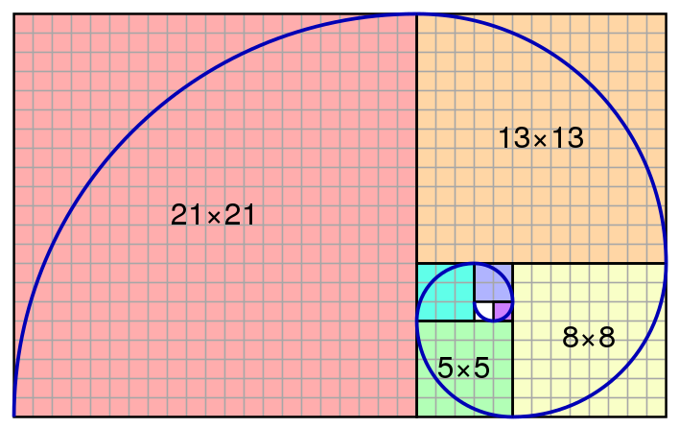
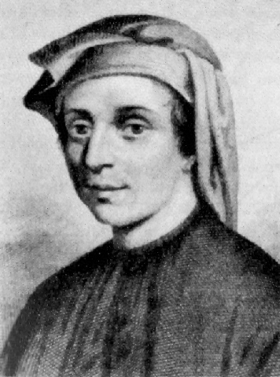
Fibonacci Sequence
n | 0 | 1 | 2 | 3 | 4 | 5 | 6 | 7 | 8 | ... | 30
fib(n) | 0 | 1 | 1 | 2 | 3 | 5 | 8 | 13 | 21 | ... | 832040
+
+
+
+
+
+
+

Slide 13
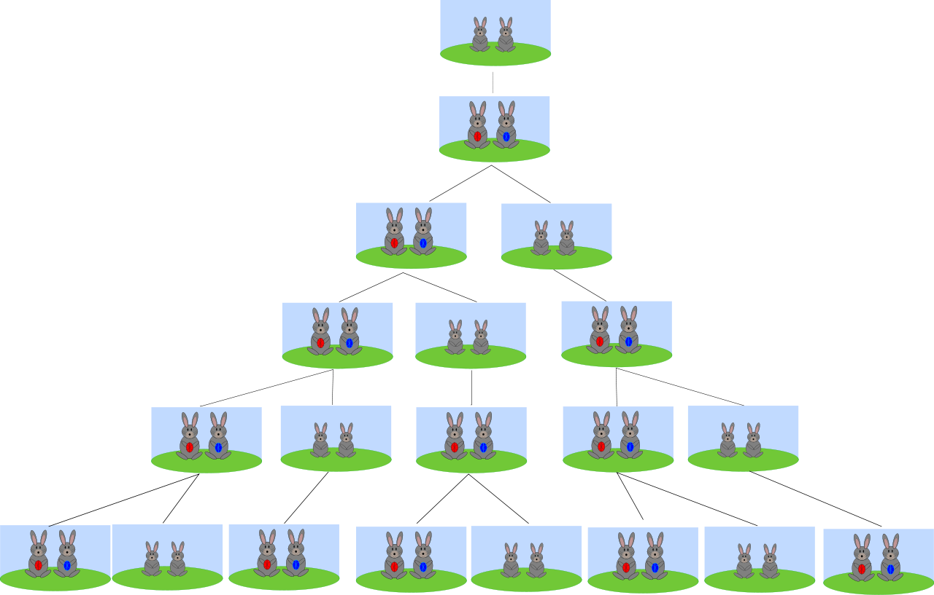
fib(1) == 1
fib(2) == 1
fib(3) == 2
fib(4) == 3
fib(5) == 5
fib(6) == 8
Fibonacci's rabbits

Slide 14
Fibonacci
Demo
Goal: Return the nth Fibonacci number.
n | 0 | 1 | 2 | 3 | 4 | 5 | 6 | 7 | 8 | ... | 30
fib(n) | 0 | 1 | 1 | 2 | 3 | 5 | 8 | 13 | 21 | ... | 832040
Ideas:
The first two Fibonacci numbers are known; if we ask for the 0th or 1st Fibonacci number, we know it immediately
Otherwise, we sum up the previous two Fibonacci numbers
1 def fib(n):
1 def fib(n):
2 if n == 0:
3 return 0
4 elif n == 1:
5 return 1
1 def fib(n):
2 if n == 0:
3 return 0
4 elif n == 1:
5 return 1
6 else:
7 return fib(n - 2) + fib(n - 1)
Notes:
Think to place in line problem.

Slide 15
Fibonacci Call Tree
fib(5)
fib(3)
fib(4)
fib(1)
fib(2)
fib(2)
fib(3)
1
fib(0)
fib(1)
fib(0)
fib(1)
fib(1)
fib(2)
0
1
0
1
1
fib(0)
fib(1)
fib(n): a tree-recursive process
0
1

Slide 16
Broken Fibonacci
Wrong value
Error
1 def fib(n):
2 if n == 0:
3 return 0
4 elif n == 1:
5 return 1
6 else:
7 return fib(n - 1) + fib(n - 2)
1 def broken_fib(n):
2 if n == 0:
3 return 0
4 # Missing base case!
5 else:
6 return broken_fib(n - 2) + ……………………………….. broken_fib(n - 1)
broken_fib(5)
broken_fib(3)
>>> broken_fib(5)
Traceback (most recent call last):
...
RecursionError: maximum recursion depth exceeded in comparison
broken_fib(1)
broken_fib(-1)

Slide 17
fib(5)
fib(3)
fib(1)
fib(-1)
Never computed!
fib(-3)
Broken fib(n)

Slide 18
Counting Partitions

Slide 19
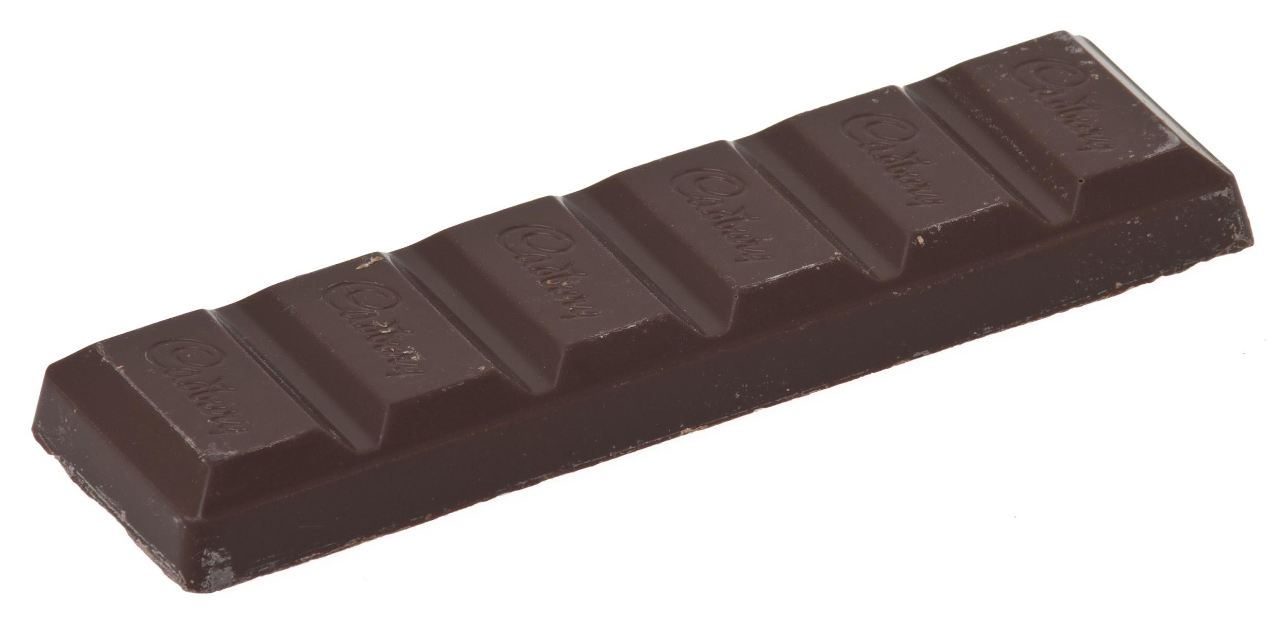
Count Partitions
Goal: Count the number of ways to give out n ( > 0) pieces of chocolate if nobody can have more than m (> 0) pieces.
"How many different ways can I give out 6 pieces of chocolate if nobody can have more than 4 pieces?"
>>> count_part(6, 4)
9
Largest Piece: 4
2 + 4 = 6
1 + 1 + 4 = 6
2 + 2 + 2 = 6
1 + 1 + 2 + 2 = 6
1 + 1 + 1 + 1 + 2 = 6
Largest Piece: 2
3 + 3 = 6
1 + 2 + 3 = 6
1 + 1 + 1 + 3 = 6
Largest Piece: 3
Largest Piece: 1
1 + 1 + 1 + 1 + 1 + 1 = 6

Slide 20
Count Partitions
2 + 4
1 + 1 + 4
3 + 3
1 + 2 + 3
1 + 1 + 1 + 3
2 + 2 + 2
1 + 1 + 2 + 2
1 + 1 + 1 + 1 + 2
1 + 1 + 1 + 1 + 1 + 1

Slide 21
Count Partitions
Ideas:
Find simpler instances of the problem
Explore two possibilities:
Use a 4
Don’t use a 4
Solve two simpler problems:
count_part(2, 4)
count_part(6, 3)
Sum up the results of these smaller problems!

Slide 22
Count Partitions
Ideas:
Find simpler instances of the problem
Explore two possibilities:
Use a 4
Don’t use a 4
1 def count_part(n, m):
2 if
3 else:
4 with_m = count_part(n-m, m)
5 wo_m = count_part(n, m - 1)
6 return with_m + wo_m
Solve two simpler problems:
count_part(2, 4)
count_part(6, 3)
Sum up the results of these smaller problems!

Slide 23
Count Partitions
How do we know we’re done?
Use a 4
(6, 4)
Don’t use a 4
If n is negative, then we cannot get to a valid partition
(2, 4)
(6, 3)
Use a 4
Don’t use a 4
If n is 0, then we have arrived at a valid partition
(-2, 4)
(2, 3)
...
Use a 3
Don’t use a 3
0
(-1, 3)
(2, 2)
4 + 4 + ... ≠ 6
Use a 2
Don’t use a 2
If the largest piece we can use is 0, then we cannot get to a valid partition
0
(0, 2)
(2, 1)
1
(1, 1)
(2,0)
4 + 2 = 6
(0, 1)
(1, 0)
0
1
0

Slide 24
Count Partitions
Demo
Ideas:
Explore two possibilities:
Use a 4
Don’t use a 4
1 def count_part(n, m):
2 if n == 0:
3 return 1
4 elif n < 0:
5 return 0
elif m == 0:
return 0
8 else:
9 with_m = count_part(n-m, m)
10 wo_m = count_part(n, m - 1)
11 return with_m + wo_m
1 def count_part(n, m):
if n == 0:
return 1
elif n < 0:
return 0
elif m == 0:
return 0
else:
with_m = count_part(n - m, m)
wo_m = count_part(n, m - 1)
return with_m + wo_m
1 def count_part(n, m):
if n == 0:
return 1
elif n < 0:
return 0
elif m == 0:
return 0
else:
9 with_m = count_part(n-m, m)
10 wo_m = count_part(n, m - 1)
11 return with_m + wo_mo_m
1 def count_part(n, m):
2 if n == 0:
3 return 1
4 elif n < 0:
5 return 0
6 elif m == 0:
7 return 0
8 else:
9 with_m = count_part(n-m, m)
10 wo_m = count_part(n, m - 1)
11 return with_m + wo_m
Solve two simpler problems:
count_part(2, 4)
count_part(6, 3)
Sum up the results of these smaller problems!
How do we know we’re done?
If n is 0, then we have arrived at a valid partition
If n is negative, then we cannot get to a valid partition
If the largest piece we can use is 0, then we cannot get to a valid partition
Notes:
http://pythontutor.com/composingprograms.html#code=def%20count_part%28n,%20m%29%3A%0A%20%20%20%20if%20n%20%3D%3D%200%3A%0A%20%20%20%20%20%20%20%20return%201%0A%20%20%20%20elif%20n%20%3C%200%3A%0A%20%20%20%20%20%20%20%20return%200%0A%20%20%20%20elif%20m%20%3D%3D%200%3A%0A%20%20%20%20%20%20%20%20return%200%0A%20%20%20%20else%3A%0A%20%20%20%20%20%20%20%20with_m%20%3D%20count_part%28n%20-%20m,%20m%29%0A%20%20%20%20%20%20%20%20wo_m%20%3D%20count_part%28n,%20m%20-%201%29%0A%20%20%20%20%20%20%20%20return%20with_m%20%2B%20wo_m%0A%0Aresult%20%3D%20count_partitions%285,%203%29%0A%0A%23%201%20%2B%201%20%2B%201%20%2B%201%20%2B%201%20%3D%205%0A%23%201%20%2B%201%20%2B%201%20%2B%202%20%20%20%20%20%3D%205%0A%23%201%20%2B%202%20%2B%202%20%20%20%20%20%20%20%20%20%3D%205%0A%23%201%20%2B%201%20%2B%203%20%20%20%20%20%20%20%20%20%3D%205%0A%23%202%20%2B%203%20%20%20%20%20%20%20%20%20%20%20%20%20%3D%205%0A&cumulative=true&curInstr=0&mode=display&origin=composingprograms.js&py=3&rawInputLstJSON=%5B%5D

Slide 25
Takeaways
Tree recursion allows you to explore different possibilities
Oftentimes, the recursive calls for tree recursion represent different choices
One such choice is “do I use this value, or do I try another?”
Sometimes it is easier to start with the recursive cases, and see which base cases those lead you to

Slide 26
If Time - Speeding Up Recursion
(Teaser for the ~Future~)

Slide 27
Back to Fib
Demo
fib(5)
fib(3)
fib(4)
fib(1)
fib(2)
fib(2)
fib(3)
1
fib(0)
fib(1)
fib(0)
fib(1)
fib(1)
fib(2)
0
1
0
1
1
fib(0)
fib(1)
0
1

Slide 28
Basic Idea to Improve:
1 def better_fib(n):
2 if n == 0:
3 return 0
4 elif n == 1:
5 return 1
6 elif already called better_fib(n):
7 return stored value
8 else:
9 store & return better_fib(n - 2) + better_fib(n - 1)

Slide 29
Summary
Recursion has three main components
Base case/s: The simplest form of the problem
Recursive call/s: Smaller version of the problem
Use the solution to the smaller version of the problem to arrive at the solution to the original problem
When working with recursion, use functional abstraction: assume the recursive call gives the correct result
Tree recursion makes multiple recursive calls and explores different choices
Use doctests and your own examples to help you figure out the simplest forms and how to make the problem smaller

